Slide 1
CNN on CIFAR-10
GROUP 8
Ronak mistry
Divija Chandhupatla
Rohini Mandewalkar
Yingrui Zhang

Slide 2
Problem – Image Classification
The problem at hand is to perform a form of supervised image classification and categorize images based on features extracted.
This problem is complicated due to the near infinite number of permutations of shapes, positions, orientations, lighting and so on.

Slide 3
DATASET - CIFAR-10
The CIFAR-10 dataset consists of 60000 32x32 color images in 10 classes, with 6000 images per class.
Classes include common objects such as airplanes, automobiles, birds, cats and so on.
The dataset is divided into train dataset with 50000 images and test dataset, with 10000 images. The test dataset contains exactly 1000 randomly-selected images from each class. The training dataset contains the remaining images in random order.
The photos are in color with red, green and blue components, but are small measuring 32 by 32 pixel squares.

Slide 4
Approach - Keras
We used Keras to solve this problem.
Keras is a Python library for deep learning that wraps the powerful numerical libraries Theano and TensorFlow.
It uses Tensorflow as its backend and essentially behaves like a wrapper.
Keras includes the CIFAR-10 dataset as a part of one of its packages.

Slide 5
Data Preprocessing
As the first step, we normalized the data to the range 0 to 1. Because the input values are well understood, we divided each value by the maximum observation which is 255.
This gives us each image with pixel values ranging between 0.0 and 1.0
We then used a one hot encoding(to_categorical in Keras) to transform the labels into categorical values.
As there are 10 classes for this problem, we got a binary matrix with width 10.

Slide 6
Model design
Training for More Epochs
Our model was trained with a varying number of epochs. We observed that performance gains were achieved by significantly raising the number of training epochs.
Image Data Augmentation.
Another boost in model performance was achieved by using data augmentation. Methods such as Horizontal and vertical shifts, Horizontal and vertical flips, and rotation were implemented. This helps generalize the model and prevents overfitting.

Slide 7
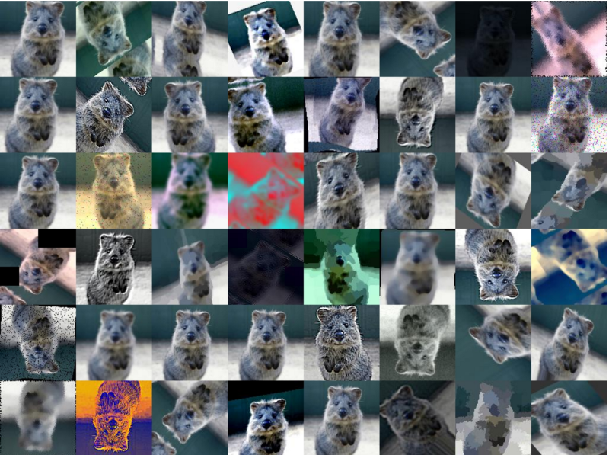
Model design
Image Augmentation

Slide 8
Model design
Layers
We performed a large number of variations based on the number of layers in our model. We implemented between 2 and 8 convolution layers. We also tried to assess how dropout layers help. Another variation was adding extra fully connected layers to see if we have any gains.
Loss functions
We implemented different loss functions like MSE, Cosine Proximity and hinge to assess which performed best with the given dataset.

Slide 9
Model design
Varying optimizers
We ran the exact same model with different optimizers to gauge their performance and pick the optimal optimizer. This included tweaking the learning rate and the decay. We used SGD, Adagrad, Adam and RMSprop.

Slide 10
Model design
Varying batch size
Based on our observations, increasing the batch size seems to have a negative impact on the model. The batch sizes we used range between 16 and 128.

Slide 11
GPU Optimization
We were able to configure Tensorflow to run using the GPU.
This greatly increased the speed at which we could train models.
For instance, a model with 2 conv layers and 1 fully connected layer running 50 epochs ran for 3.5 hours on the normal version of Tensorflow.
The GPU optimized version ran the same model in an hour.
This allowed us to perform multiple variations of the model in a short period of time.

Slide 12
Tensorboard
We leveraged tensorboard for this project.
All the permutations and combinations we performed could be easily assessed and tracked using this feature.
It helped us narrow down on the components to use for the final model.

Slide 13
Final Model Design
Conv 1 16 Filters
Conv 2 16 Filters
Max Pooling
Dropout Layer
Conv 3 64 Filters
Conv 4 64 Filters
Dropout
Conv 5 128 Filters
Max Pooling
Dropout
Flattening layer
Dense Layer

Slide 14
Results
At peak performance, we were able to achieve an accuracy of about 84%.
The lowest loss we achieved was 0.4 .

Slide 15
Thank you

